Slide 1
Text to SQL processing using Langchain and openAI

Slide 2
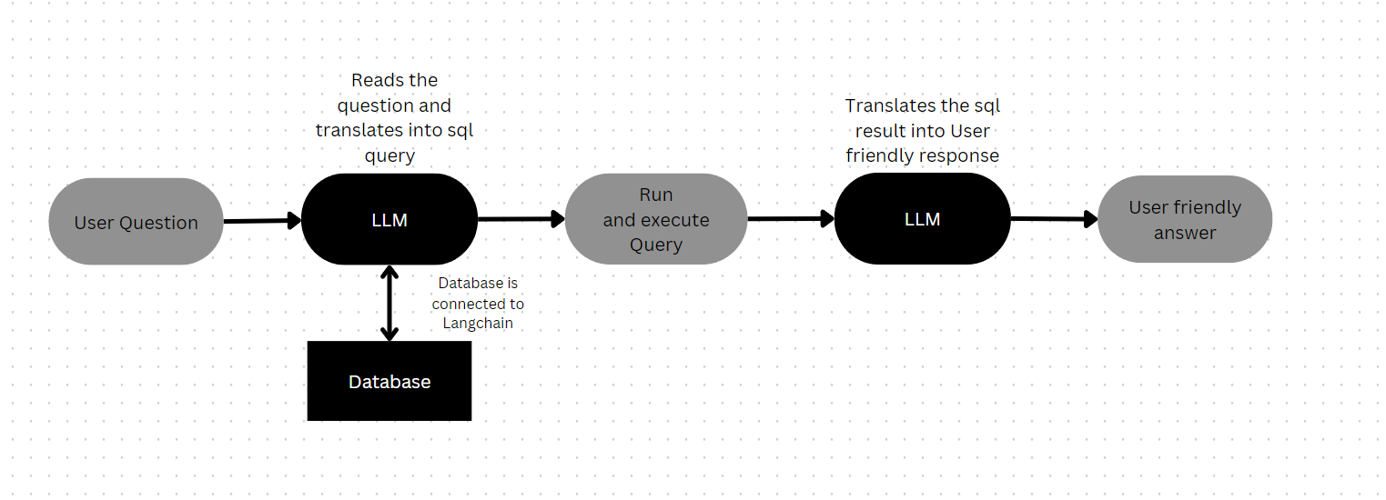
Flow chart:

Slide 3
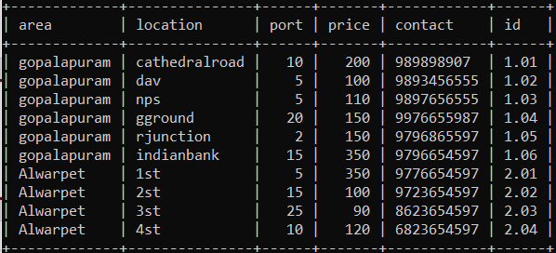
Database used for this project is ‘Stations’ :

Slide 4
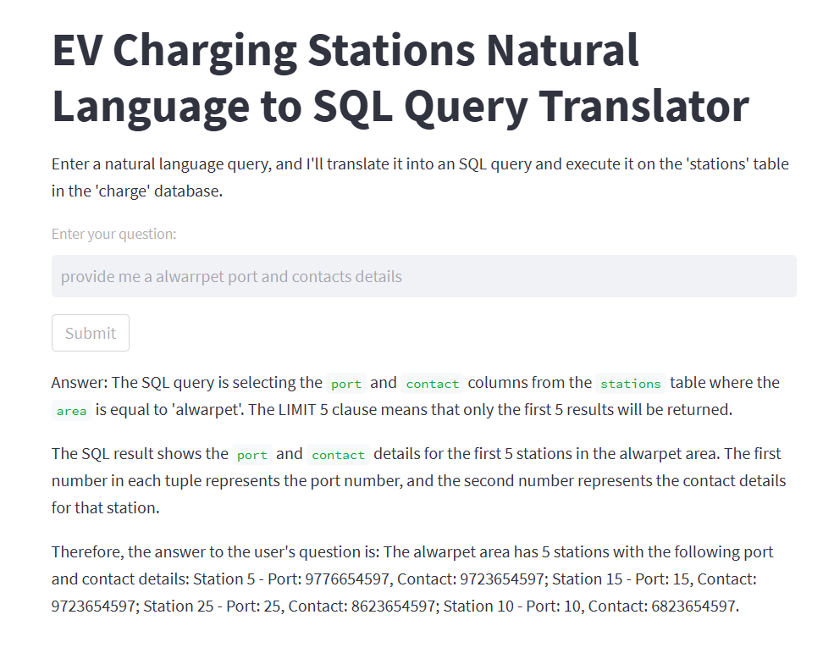
Result:
The user question is entered in the text box and the output is seen below

Slide 5
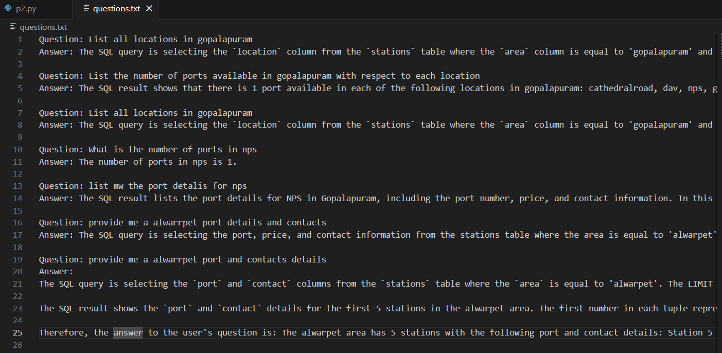
The question asked by user and the answer given by the model, both are recorded in a text file ‘Questions.txt’ :

Slide 6
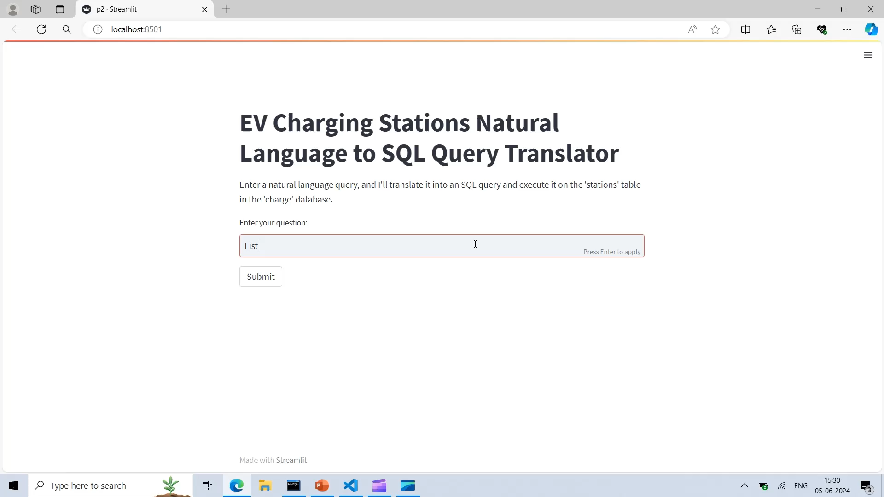
Video presentation:

